Slide 1


Walk With Ease
Self-Directed Enhanced for Trained Leaders
Notes:
Thank you for choosing to learn more about Walk With Ease and how it can be implemented by as self-directed program where most or all of the program will be completed individually. Your primary role is all about motivating your network to participate in the program, stay organized and energized to complete the full six weeks. Let’s begin!

Slide 2
Walk With Ease / COVID-19
Most shelter-in-place mandates allow for people to go outside and engage in outdoor activity, including walking.
  Follow the directions of your local health authority.
Always practice physical distancing and wash your hands before you leave and as soon as you get home.
Do not exercise if you have a fever, cough and difficulty breathing.

Slide 3
Program Goals
Gain an understanding of the basics of arthritis, and the relationship between arthritis, exercise and pain
Learn how to exercise safely and comfortably
Use methods to make walking fun
Develop and implement a doable, personal walking plan with realistic goals for improved fitness
Gather tips, strategies and resources that will help participants maintain a long-term exercise routine
Learn about other programs and resources that help participants keep up their walking
Notes:
First, let review the goals of Walk With Ease. By the end of the program participants should –
READ list -

Slide 4
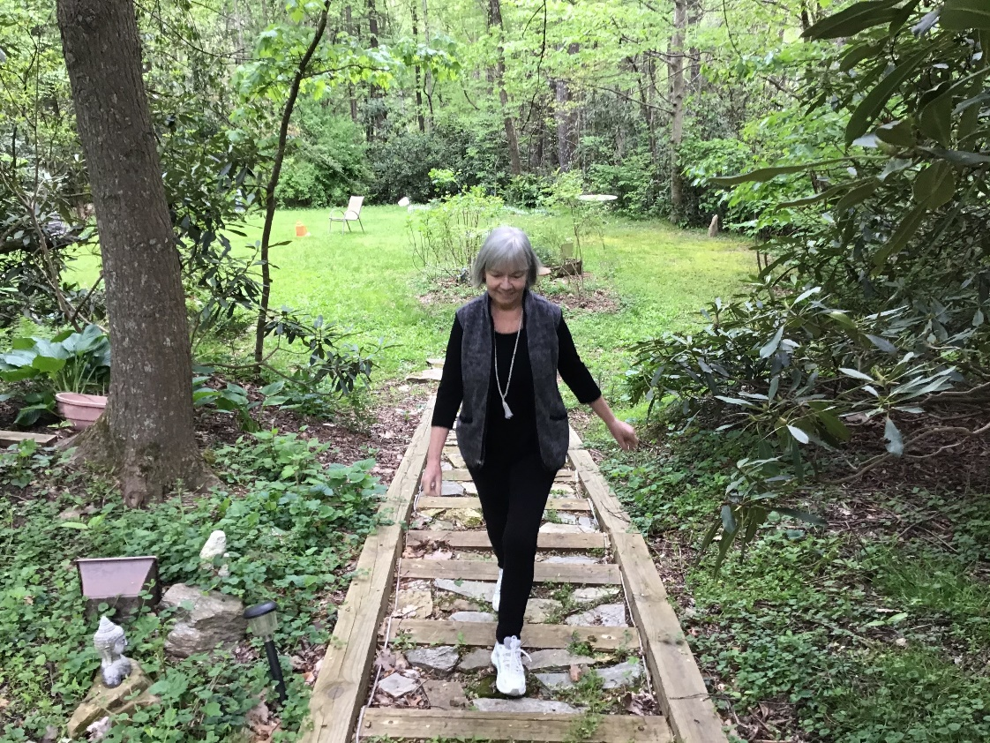
Essential Components
Health information
Walking
Exercises
Motivational strategies
Notes:
Walk With Ease is more this just a walking – The program includes –
Read list

Slide 5
Self- Directed Enhanced Program Structure
Six-week program
Participants walk at least three times per week
As a leader you coordinate communication and optional group walks
  You may share both the health lecturettes and stretching strengthening exercises
Notes:
Here’s the framework of the Walk With Ease program. Here I’m specifically talking about the self-directed program.
Read list

Slide 6
Walking in the Community
Sidewalks
Parks, trails and greenways
  Ensure surface is appropriate for your fitness level
Community schools with tracks
  Refer to community dual use guidelines
Trails and greenways
University / Corporate Campuses
  Review rules for use
Indoor shopping malls

Slide 7

Reminders
Obtain permission from a sponsoring organization
  Employer, place of worship, community organization
  Determine any requirements for registration/waivers
Fidelity: Do NOT add, change or delete any parts of the program.
Do NOT offer medical diagnosis or treatment. Refer all participants with medical questions to his/her health care provider.
Notes:
7
Here’s note about logistics -

Slide 8
Program Implementation
Self-Directed Enhanced
Notes:
Now that we better understand the program, let’s talk about your role as a program coordinator

Slide 9
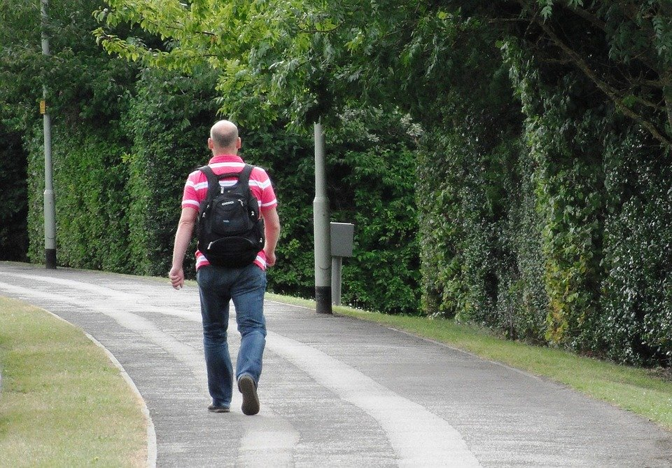
Task List
Select dates
Promote
Register participants
Distribute guidebooks
Start the class
Engage participants
Celebrate & evaluate
Notes:
Let’s quickly review our task list –
Choose a start and end date – remember it’s a six-week program
Promote the class to recruit your crew
Distribute guidebooks – we have a few methods to choose from
Start the class
Engage and motivate participants
Then when it’s all done celebrate and evaluate your and participants success

Slide 10
Select Dates
Select a start and end date
Think ahead
Weather
Holidays
School/work schedule
Notes:
First choose a date to start and end your classes
While no date is perfect think about a date range that would have less disruption with severe weather, holidays and major changes in school and work schedules.

Slide 11
Promote
Personal ask
Email
Social media posts
Newsletters/Blogs
Flyers
Kick-off event!
Optional: Incentives
Notes:
Now its time to spread the word –
The best way to recruit anybody to anything is with a sincere personal ask.
You can increase your reach with email, social media, newsletters and blogs
If your event is open to the public, share it with the Arthritis Foundation to post it on the arthritis.org/events page
The Arthritis Foundation also
Generate interest with a Kick-off event! Talk about programs benefits! Help answer questions.
If you using incentives – pedometers, gift cards – be sure to be clear about any guidelines for receiving – registration? Completing? Reporting?

Slide 12

Target Market
Adults with arthritis
Adults who don’t have arthritis
Range from beginners to the physically fit
Able to be on their feet for 10 minutes without increased pain
Notes:
Let’s take a step back to remember our audience for Walk With Ease. This can shape your recruiting strategies –
Walk With Ease was developed specifically for adults who have arthritis who have the desire to incorporate walking as a routine activity into their lives. Adults who don’t have arthritis may also find the program beneficial.
The program is designed for a range of activity levels, from adults who may be new to physical activity and beginners in a walking program to those adults who have been physically active.
The Walk With Ease program does require that participants be able to be on their feet for 10 minutes without increased pain - this may be for doing things like household chores, shopping or social activities.

Slide 13

Register Participants
Check with your sponsoring organization first
Keep a list of everyone who has signed up
  Spreadsheets, apps and webtools
Respect any individual or organization privacy
  Optional: collect program fees

Slide 14
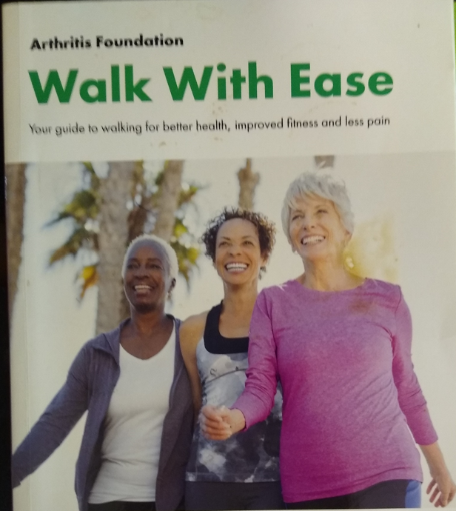
Distribute Participant Guidebooks
Where to buy books
www.AFstore.org - $11.95 (discounts available)
Amazon Kindle
Distribution Method
Individual purchase
Direct Delivery
Distribution Hub
E-delivery (Kindle version only)
Notes:
Everyone who participates in the Walk with Ease program needs a guidebook, sometimes referred to as a participant book. You can purchase the hard copy book online at Afstore.org. You can also purchase an Amazon Kindle version - $5.98. You do not need a Kindle device, just the free Kindle app.
If your organization is buying books in bulk, needs to pay by check or needs submit a PO or receive an invoice, contact the Arthritis Foundation.
You’ve got a few options for distributing books – here are the most common options
Individual purchase
Direct delivery
Distribution hub
E-delivery

Slide 15

Start Class
Notes:
Give everyone a reminder a heads up a few days before class.
Be sure everyone has a book and is ready to go!
If there are optional group walks, be sure to share info about meeting locations and times.

Slide 16
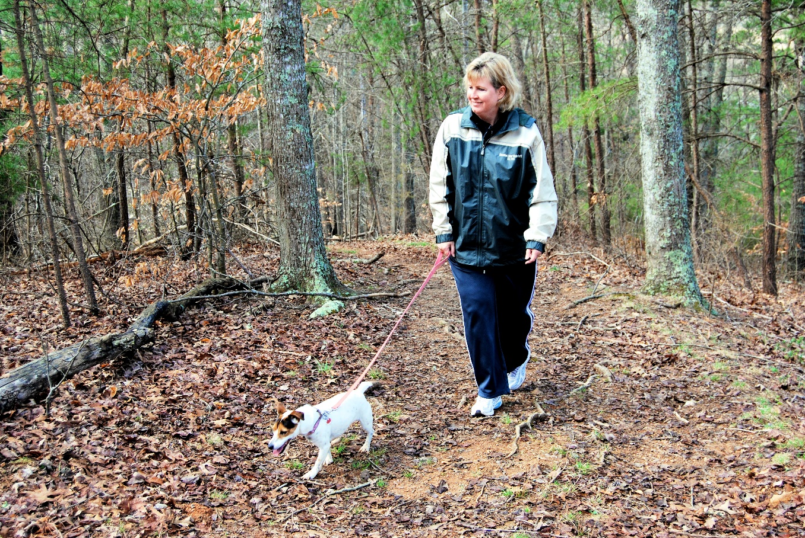
Keep participants engaged
Weekly emails / posts
Digital tools
Share pictures
Share victories

Slide 17
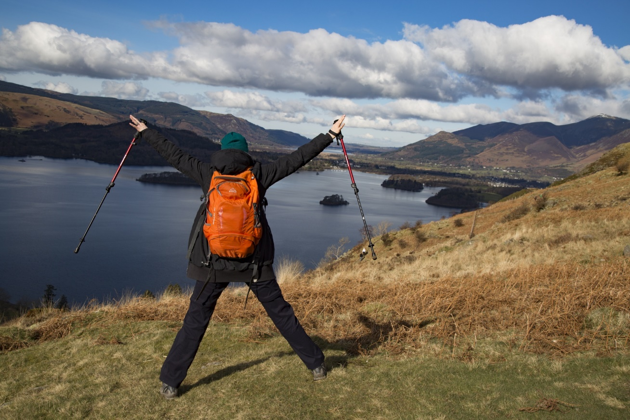
Celebrate!
Recognize all participants
Encourage participants to continue to use walking contract
Keep in touch!
Suggesti distance theme/challenges and hold celebrations when the group achieves milestones
Introduce participants to other programs and resources that are designed for people with arthritis
Final paperwork – surveys or other forms
Volunteer opportunities to host a new session!

Slide 18
Additional Resources
Arthritis Foundation
  www.arthritis.org
CDC
  https://www.cdc.gov/arthritis/
National Association Chronic Disease Directors
  https://www.chronicdisease.org/
National Recreation and Parks Association
  https://www.nrpa.org/our-work/partnerships/initiatives/healthy-aging-in-parks/evidence-based-interventions/
OA Action Alliance
  https://oaaction.unc.edu/resource-library/

